Slide 1

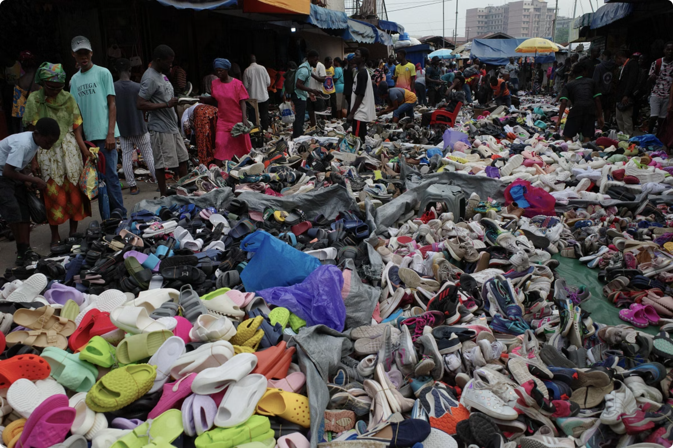

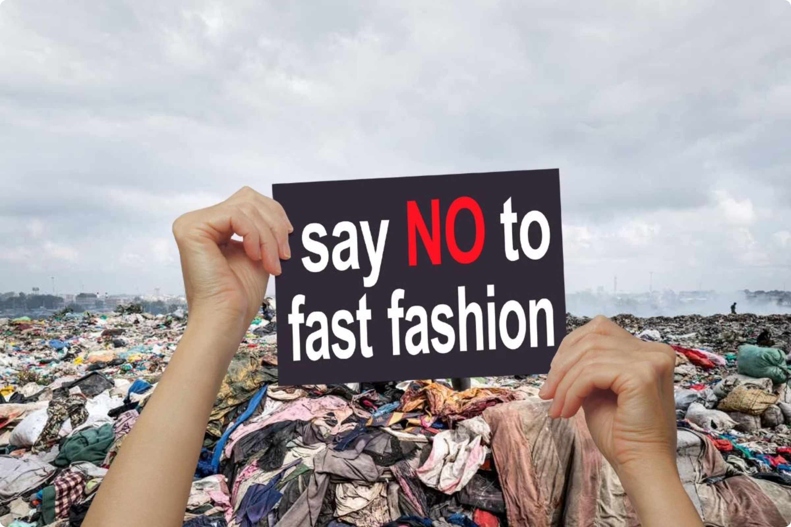

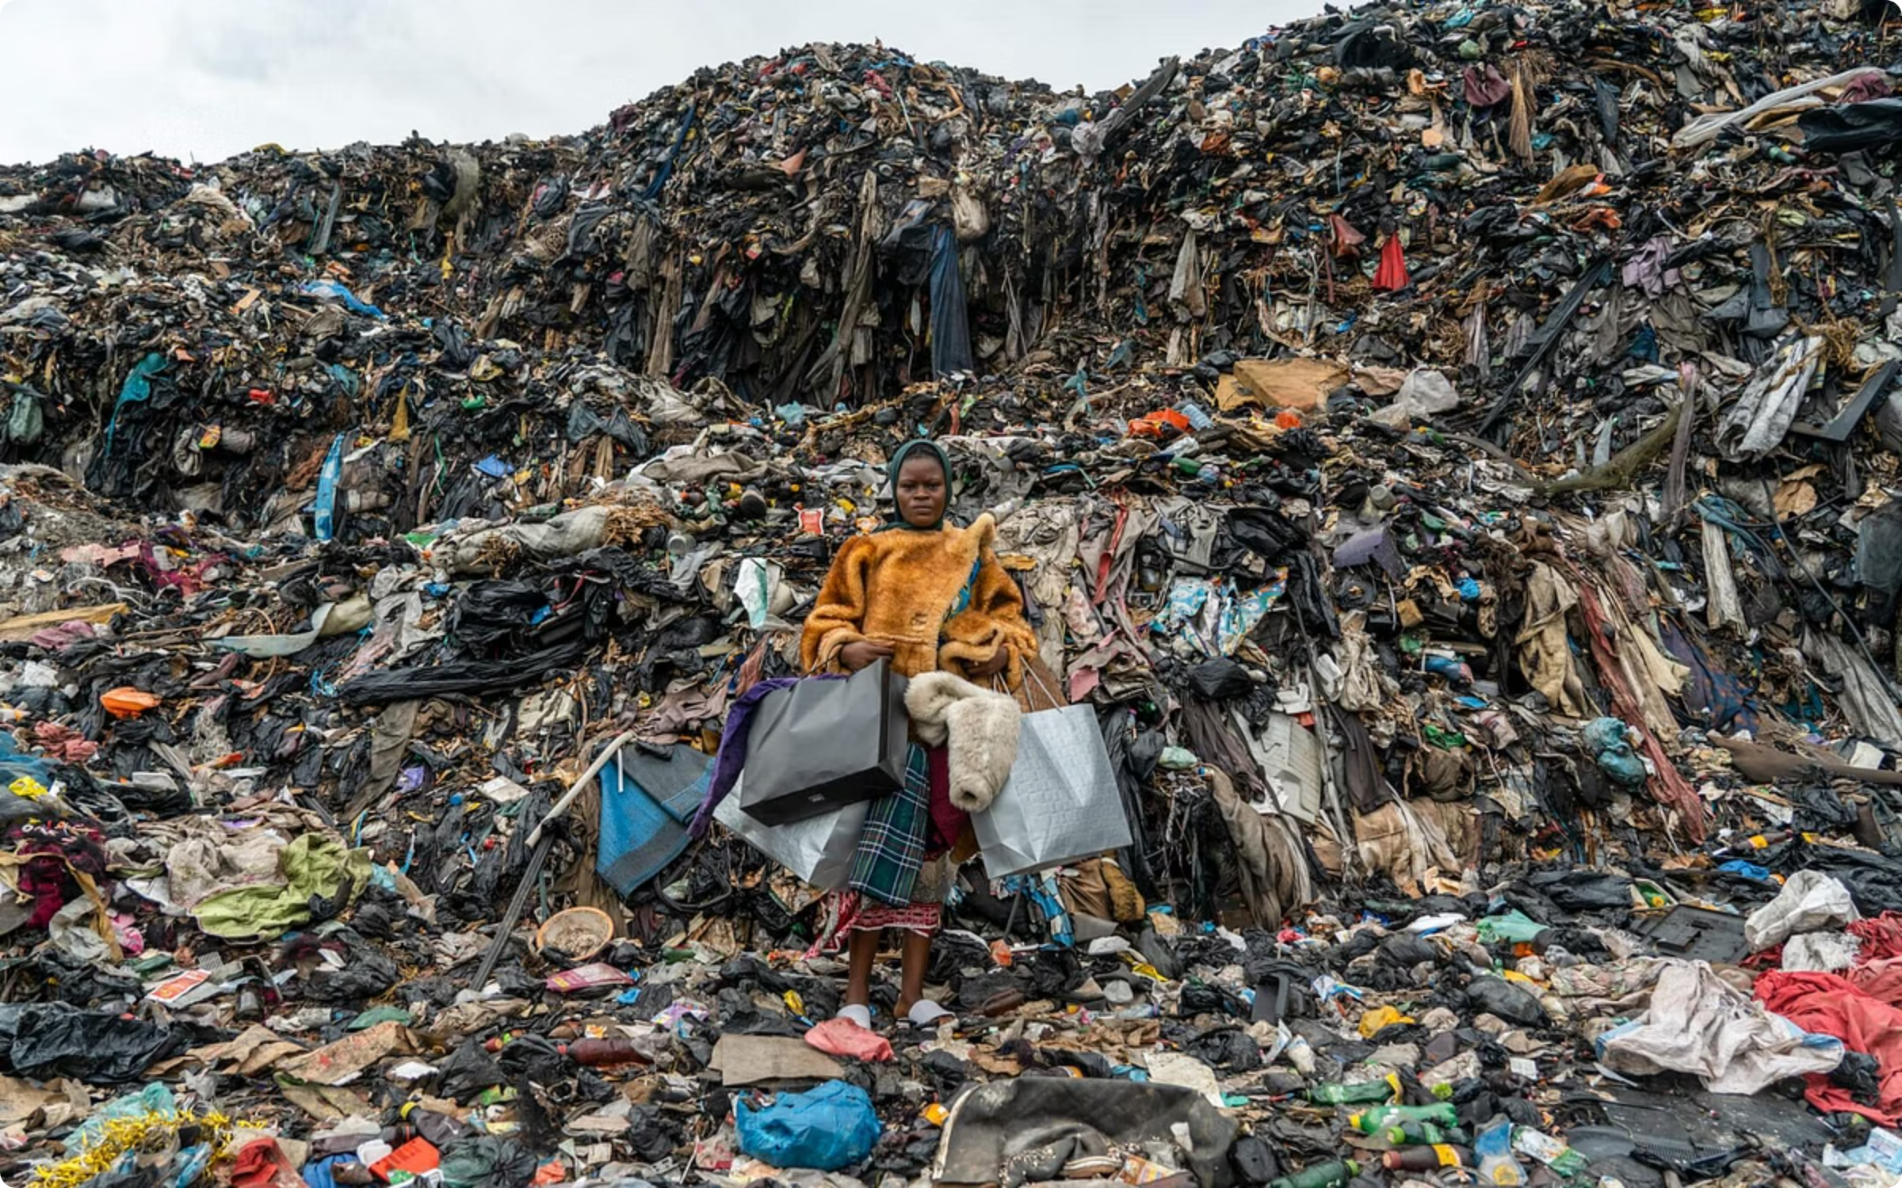

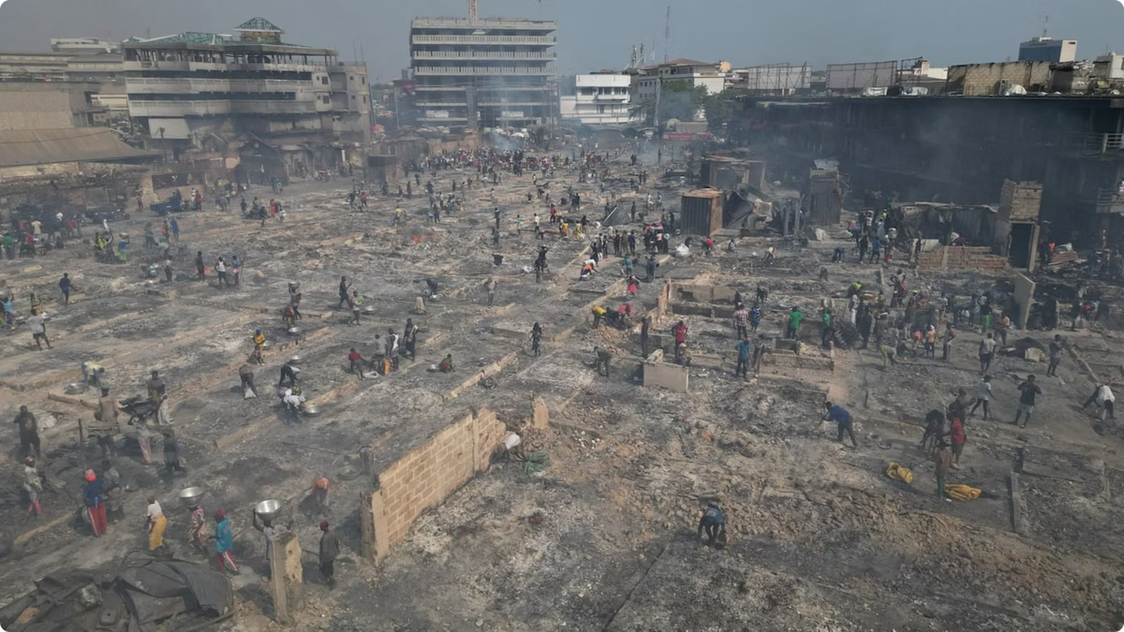
Threads and Temperature
By:
AL YAMAN AL-NAABI
JIA MIN TAN
KATE MCHUGH
MALCOLM MACLEOD

Slide 2
Fast fashion (climate & inequality)
1
The fashion sector drives ~2–8% of global greenhouse gas emissions, ~9% of microplastic releases to oceans, and uses ~215 trillion litres of water a year (UNEP, 2023) .
2
Climate change and pollution from these systems affects marginalised communities the most. So, it’s a climate-justice problem, not just an environmental one (Encompass HK, 2022).

Slide 3
The donation myth
1
Donated clothes in the UK/EU are often sold into opaque export chains; Accra’s Kantamanto market receives ~15 million garments every week (Webb, 2025) .
2
UK exports to Ghana were ~57,000 tonnes in 2024 (among the highest globally), with some flows routed via UAE sorting hubs (Bennett, 2025).
3
Fast fashion clothes’ quality is getting worse, and traders buy sealed bales, reporting that ~40% is unwearable, turning “donations” into waste (Kokutse, 2024).

Slide 4
Who pays the price?
1
Low-income Accra areas like Old Fadama and Densu Delta breathe smoke from burning clothes and blocked drains make floods worse (Jordan, 2025).
2
Women and girls working as porters and traders face smoke and injuries. Also, fires and floods destroy stalls (Johnson, 2025).
3
Fishers near Korle Lagoon and Jamestown haul say that there are more clothes than fish. Also, Polluted water and beaches affect people’s health (Jordan, 2025).

Slide 5
Reference list:
Bennett, P. (2025). Discarded Clothing by UK Fast Fashion Brands Found in Protected Wetlands in Ghana: Report. [online] EcoWatch. Available at: https://www.ecowatch.com/discarded-clothing-uk-ghana-protected-wetland.html?utm_source=chatgpt.com [Accessed 5 Oct. 2025]
Encompass HK (2022). The Impacts of Climate Change on Marginalised Groups. [online] Earth.org. Available at: https://earth.org/marginalised-groups-are-disproportionately-affected-by-climate-change/?utm_source=chatgpt.com [Accessed 5 Oct. 2025]
Unep (2023). UNEP and UN Climate Change provide fashion communicators with practical guide to contribute to sustainable change. [online] UN Environment. Available at: https://www.unep.org/news-and-stories/press-release/unep-and-un-climate-change-provide-fashion-communicators-practical?utm_source=chatgpt.com [Accessed 5 Oct. 2025]
Johnson, S. (2025). ‘Dead white person’s clothes’ mount up as Ghana’s Kantamanto market struggles to rebuild after fire. [online] the Guardian. Available at: https://www.theguardian.com/global-development/2025/feb/24/ghana-clothes-market-fire-kantamanto-rebuild?utm_source=chatgpt.com [Accessed 5 Oct. 2025]
Jordan, L. (2025). Discarded clothes from UK brands dumped in protected Ghana wetlands. [online] the Guardian. Available at: https://www.theguardian.com/world/2025/jun/18/discarded-clothes-from-uk-brands-dumped-in-protected-ghana-wetlands?utm_source=chatgpt.com [Accessed 5 Oct. 2025]
KOKUTSE, F. (2024). Fast fashion waste is polluting Africa. In Ghana, designers find use for discarded clothing. [online] AP News. Available at: https://apnews.com/article/ghana-fashion-waste-clothing-pollution-0809f25605722a53658bf21d7d9b1548 [Accessed 5 Oct. 2025]
Webb, B. (2025). The Or Foundation leads the industry response to the Kantamanto Market fire. Here’s what it means for sustainable fashion. [online] Vogue Business. Available at: https://www.voguebusiness.com/story/sustainability/what-the-kantamanto-market-fire-means-for-sustainable-fashion?utm_source=chatgpt.com [Accessed 5 Oct. 2025]

